Slide 1
Order Statistics

Slide 2
Computing Order Statistics
k-th order statistic in {x₀,…,x_{n-1}}
k-th element in order
Median
Middle element
Half are larger
Half are smaller
Median – excellent pivot
After partition
Need to compute order statistic only on one side of partition

Slide 3
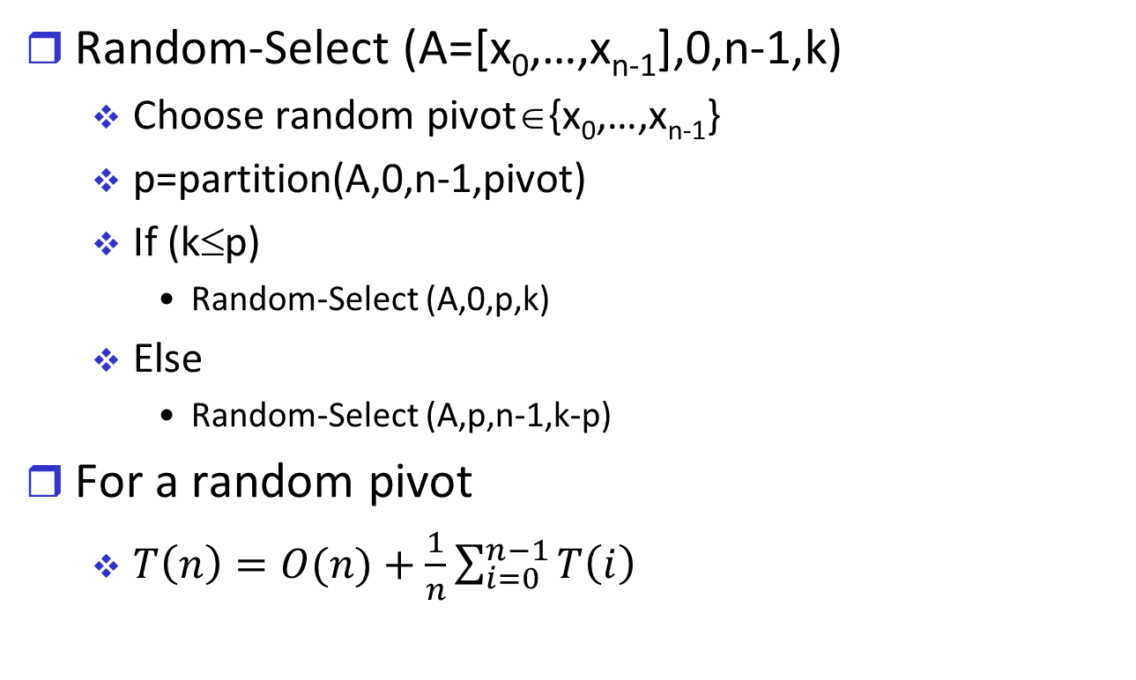
Random Select
Random-Select (A=[x₀,…,x_{n-1}],0,n-1,k)
Choose random pivot∈{x₀,…,x_{n-1}}
p=partition(A,0,n-1,pivot)
If (k≤p)
Random-Select (A,0,p,k)
Else
Random-Select (A,p,n-1,k-p)
For a random pivot
$T\left(n\right)=O(n)+\frac{1}{n}\sum_{i=0}^{n−1}{T\left(i\right)}$

Slide 4
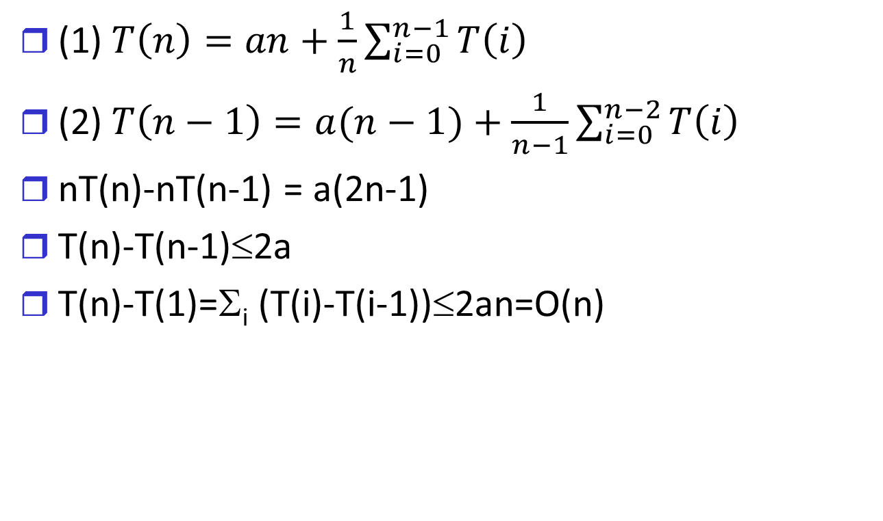
Random Select Analysis
(1) $T\left(n\right)=an+\frac{1}{n}\sum_{i=0}^{n−1}{T\left(i\right)}$
(2) $T\left(n−1\right)=a(n−1)+\frac{1}{n−1}\sum_{i=0}^{n−2}{T\left(i\right)}$
nT(n)-nT(n-1) = a(2n-1)
T(n)-T(n-1)≤2a
T(n)-T(1)=Σ_{i} (T(i)-T(i-1))≤2an=O(n)

Slide 5
Deterministic Median Algorithm
Order-Stat (A=[x₀,…,x_{n-1}],low=0,high=n-1,k)
If (low=high)
Return low
Divide x₀,…,x_{n-1} into sets of five
For every i=0,…,(n-1)/5
Let y_{i} be the median of x_{i},x_{i+1},…,x_{i+4}
q←Order-Stat(y₀,…y_{(n-1)/5},0,n/5-1,n/10)
p←Partition (A,0,n-1,q)
If (k≤p)
Return Order-Stat (A,0,p,k)
Else return Order-Stat (A,p,n-1,p-k)

Slide 6
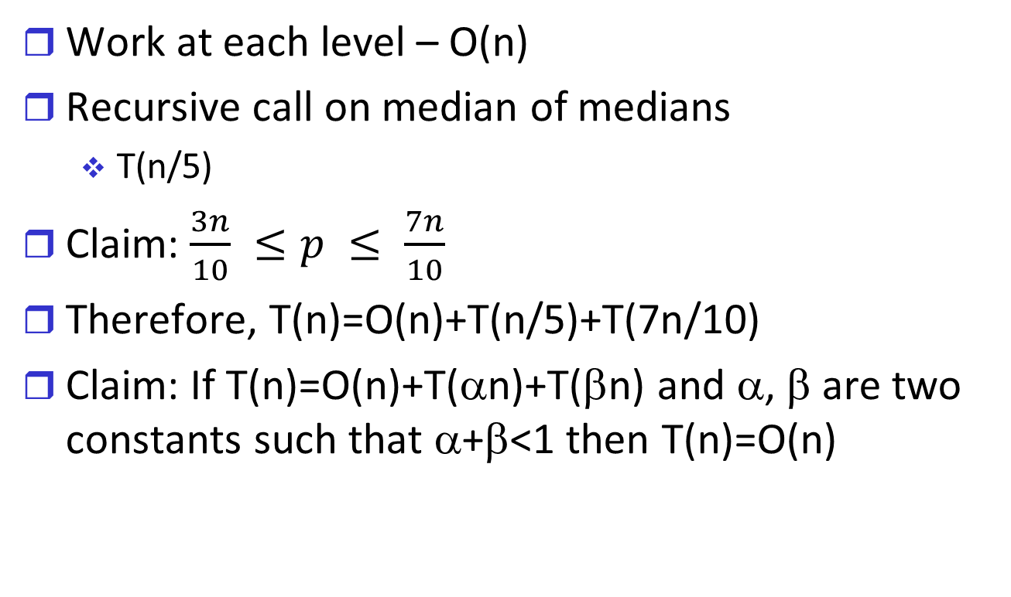
Analysis of Median Algorithm
Work at each level – O(n)
Recursive call on median of medians
T(n/5)
Claim: $\frac{3n}{10} ≤p ≤ \frac{7n}{10}$
Therefore, T(n)=O(n)+T(n/5)+T(7n/10)
Claim: If T(n)=O(n)+T(αn)+T(βn) and α, β are two constants such that α+β<1 then T(n)=O(n)

Slide 7
Comparison Model
Sorting algorithms
Insert-Sort – O(n²)
Heap-sort, Quick-sort O(n log n)
Can we do better?
Comparison model
Limited access to each input
Store and retrieve
Access ID
Only access to value is via comparison to another value

Slide 8
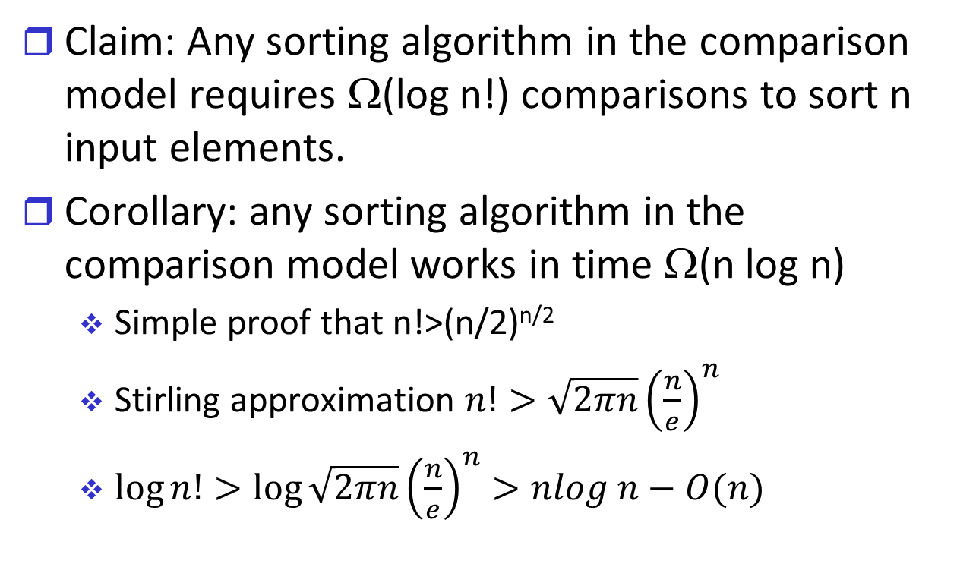
Lower Bound for Sorting
Claim: Any sorting algorithm in the comparison model requires Ω(log n!) comparisons to sort n input elements.
Corollary: any sorting algorithm in the comparison model works in time Ω(n log n)
Simple proof that n!>(n/2)^{n/2}
Stirling approximation $n!>\sqrt{2πn}{\left(\frac{n}{e}\right)}^{n}$
$\log{n!>\log{\sqrt{2πn}{\left(\frac{n}{e}\right)}^{n}>nlog n−O(n)}}$

Slide 9
Non-Comparison Sorting Algorithms

Slide 10
Bucket Sort I
Input: (x₀,…,x_{n-1}) such that x_{i}<m for all i.
Bucket-Sort (x₀,…,x_{n-1})
Let A be an array of size m
For i=0 to m-1
A[i]←0
For j=0 to n-1
A[x_{j}]←1
For i=0 to m-1
If (A[i]=1)
Print A[i]

Slide 11
Bucket Sort II
Claim: Bucket Sort is a sorting algorithm time complexity Θ(n+m).
Corollaries:
If m=o(n log n) then bucket sort outperforms comparison-based sorts.
If m=O(n) then the algorithm runs in linear time
If m=Ω(n log n) then bucket sort underperforms

Slide 12
Double Entries & Stable Sorting
What if i≠j, but x_{i}=x_{j}?
Motivating example
Database entries with multiple keys, which are not all unique
A sorting algorithm is stable if for every x_{i}=x_{j}, if i<j then x_{i} appears before x_{j} in the output
Is heap sort stable?
Is quick sort stable?

Slide 13
Stable Bucket Sort
Each entry in A is a queue
Initialize all queues to be empty
Insert each xi to the queue at A[x_{i}]
Print out A[x_{i}] by
Dequeue until queue is empty

Slide 14
Radix Sort
Input: (x₀,…,x_{n-1}), such that x_{i}<m=r^{d} for parameters r, d
Representation in radix r (i.e. basis r), no. of digits d
M/LSD – Most/Least Significant Digit
Radix-Sort (x₀,…,x_{n-1})
For j=LSD to MSD
Let x_{i}[j] denote the j-th digit of x_{i}
Stable-Bucket-Sort(x₀[j],…,x_{n-1}[j])
Example – with decimal digits

Slide 15
Radix Sort II
Claim: Radix-Sort is a sorting algorithm with time complexity O(d(n+r))
d=log_{r}m and r can be freely chosen
Example: radix sort with m=O(n), binary r
Example: radix sort with m=n², r=n
Best choice: r=n

